Slide 1
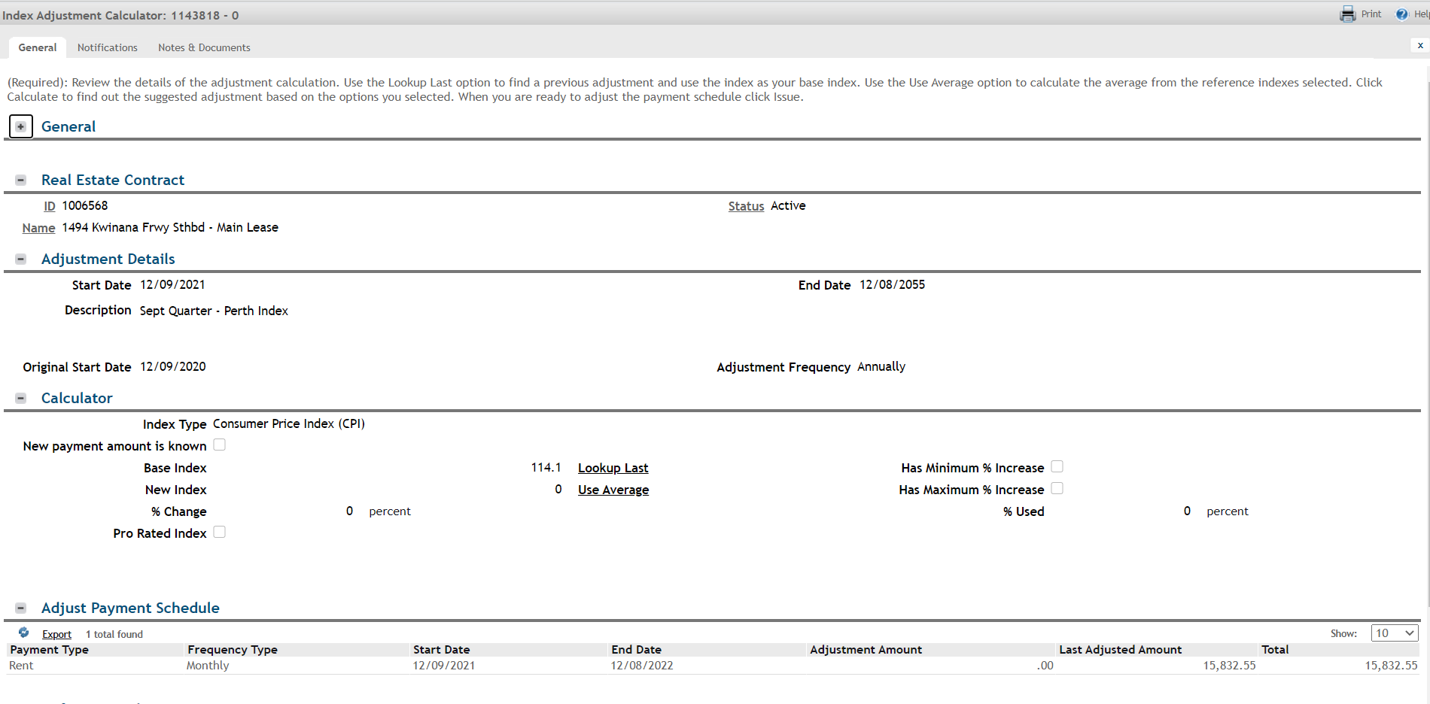
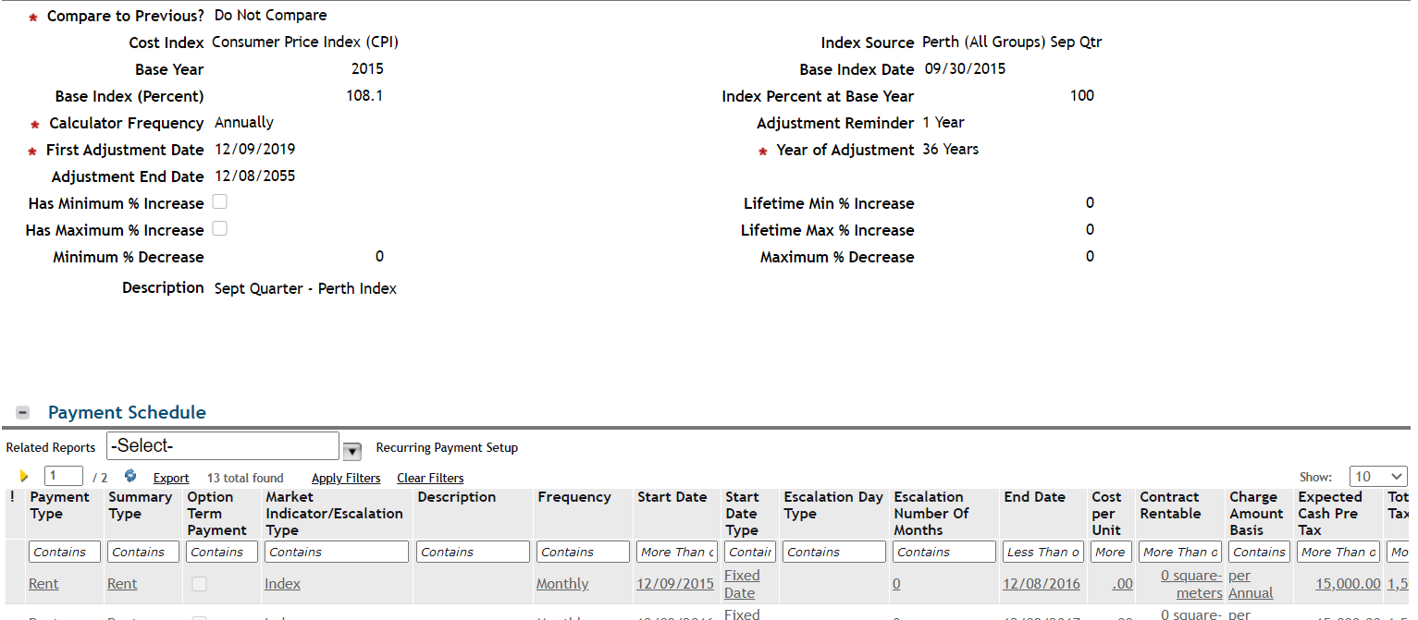
PROBLEM Statement: If the Clause, PS & Calculator creations aren’t “perfect” the first time, users aren’t able to easily self- correct: Users can’t reverse or revise calculators. Users cannot generate a new calculator without going through approval process
Users are unable to self-correct if after Issue, the end user notices the below are incorrect on the CALCULATOR
Start date
End date, or
adjustment amount
The Last Adjusted Amount frequently (15%) gets out of sync with the PLIs – we haven’t been able to RCA
Users are unable to self-correct, if after Issue, the end user notices the below are incorrect on the CLAUSE
Compare to Previous?
First Adjustment Date
Adjustment End date
Minimums/Maximums
PS associations

Slide 2
PROBLEM Statement: The system has issues with some cases both common and uncommon. We have fixed some of the issues.
Users have problems when trying to issue index for multiple payment schedules within the same period. We have added an enhancement for users to separate index clauses by clause type.
Index adjustments have problems when issuing multiple in a row. Payment amounts are wrong.
There is no option to adjust all PLIs based solely on Index %.
No support for mid-month index (prorations).
Why is index adjustment method separated by before/after scheduled end date?

