Slide 1
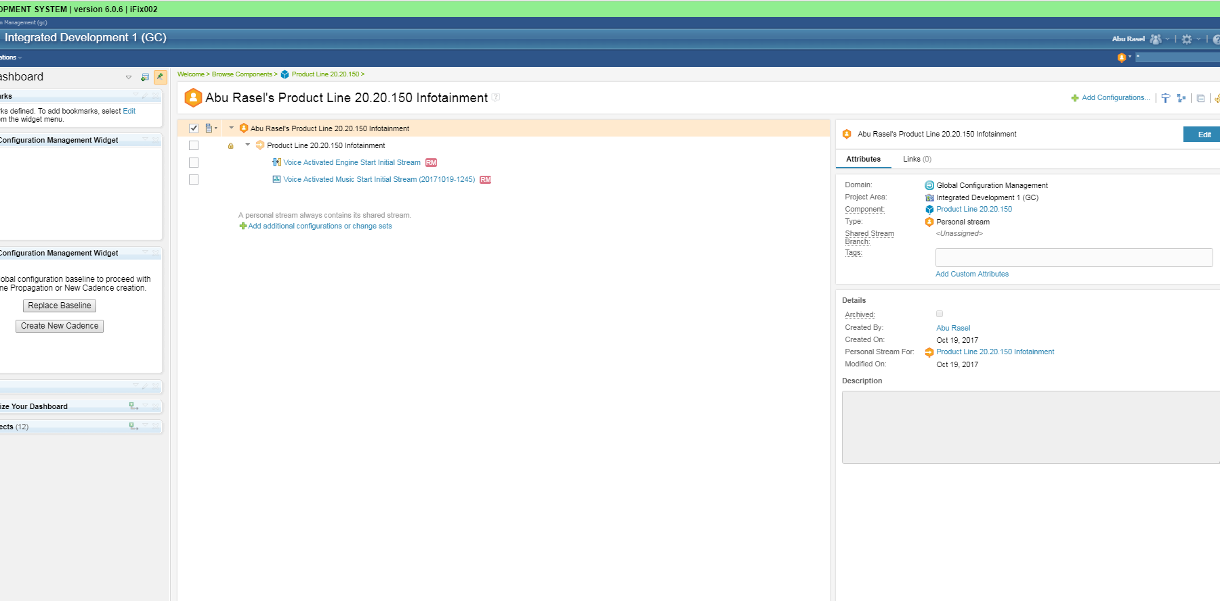
User Challenges
List of change sets

