Slide 1
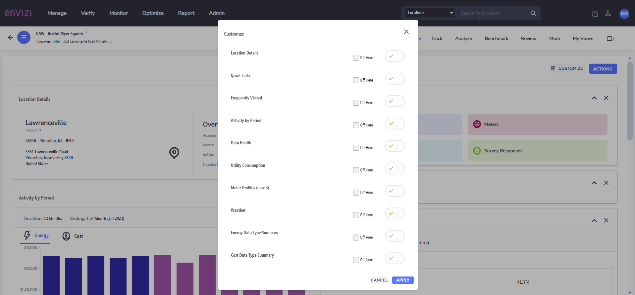
No Action Plans available to put into widgets customization on Location “home screen”

Slide 2
No Action Plans available to put into widgets customization on Location “home screen”
Issue description:
Our company largely uses the Programs module for projects; this does not exist as an option for customization for a Location summary thus rendering most of this page useless for us. Things like weather and quick links exist, but not a major module such as Programs.

