Slide 1
Improvement idea – Selectable filter affecting all queries on dashboard
Current:
Queries have to be created specifically for a dashboard even if only 1 attribute on a query changes.
Many queries needed even when the only change is one attribute, as example “found in”
Enhancement:
One selectable filter that affects all queries.
Less dashboards and specific queries needed.
By using the selectable filter all the queries would be updated by the attribute selection and show respective data.
Dashboards
Project 1 | Project 2 | … | Project x
Dashboards
Projects
Selectable filter on dashboard: | Project 2
Query 2.1 | Query 2.2 | Query 2.3
Query 2.4 | Query 2.5 | Query 2.6
Query 2.7 | Query 2.8 | Query 2.9
Query 1 | Query 2 | Query 3
Query 2.4 | Query 2.5 | Query 6
Query 7 | Query 8 | Query 9

Slide 2
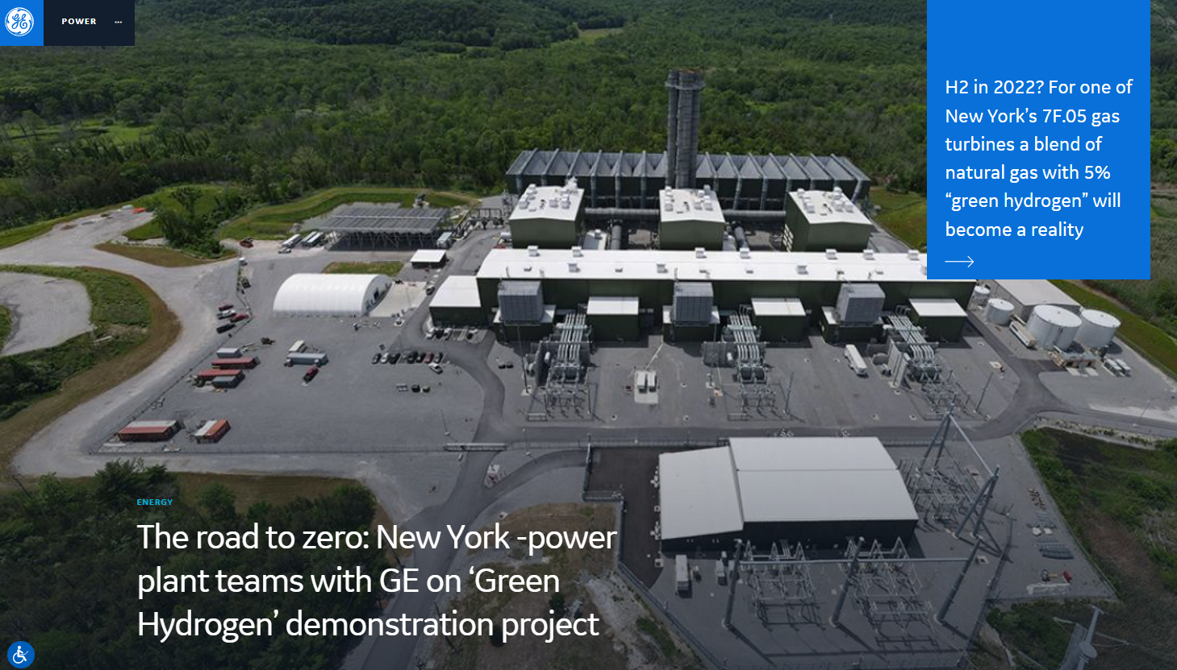
Improvement idea – Individual layout selection
Current:
Only 3 layout options.
Not possible to arrange efficiently.
Enhancement:
Allow layout to be allocated freely to show content that needs more width as easy as content that can be more compressed to be meaningful.
Query 1
Query 2
Query 1 |  |  | Query 2
Query 3 | Query 4 | Query 5
 | Query 1
Query 2
 | Query 1 | Query 2

