Slide 1
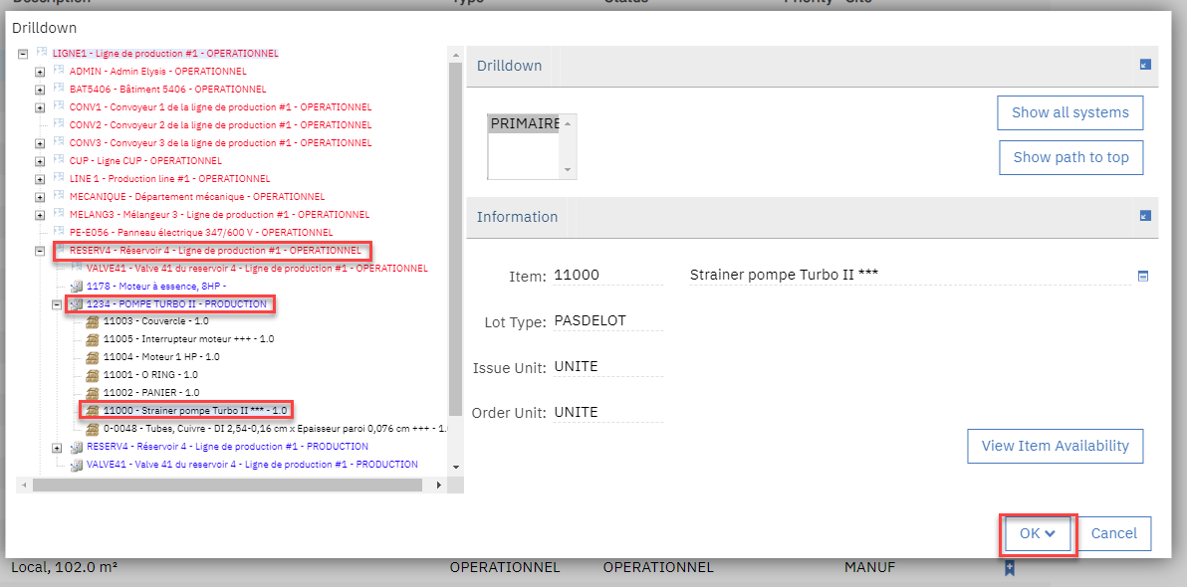
The drilldown allows some levels of Locations (ex. RESERV4, VALVE41,…) and Assets (ex. 1178, 1234,…). We also have one level for item below asset (ex. 11005). If user clicks on OK button it is possible to continue in the Item Master… (next slide)

Slide 2
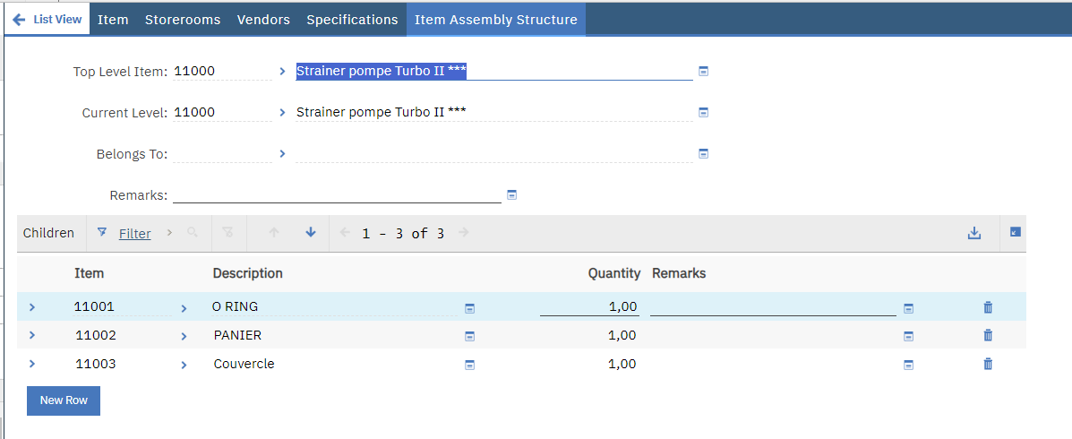
And after to see the Item Assembly Structure

Slide 3
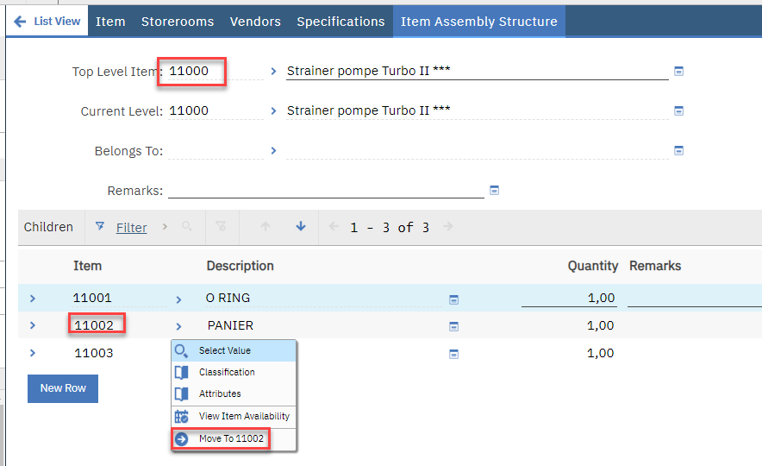
And drill below the item…

Slide 4
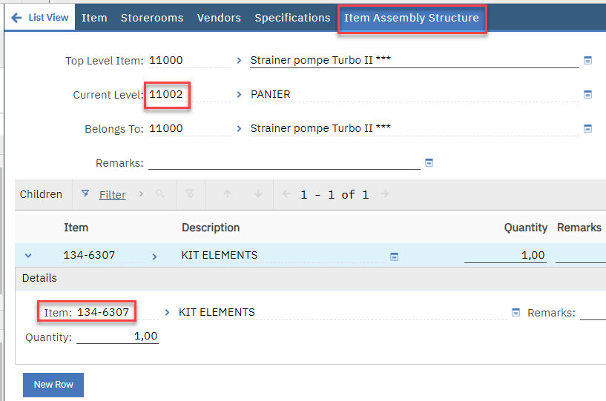
And so on…

Slide 5
Conclusion
There is no way to return back to the Locations / Assets Drilldown after clicking on OK button to access Item Master. This is a lot frustrating for a planner or maintenance technician validating items for a specific job.
It could be a lot value added to have like 3 levels of items (no more to limit impact on the way it is displayed actually). Next slide give examples with previous slides to show how it could be value added to have info in the drilldown (I do want to invest to modify this code… because it will be usefull for a lot of customers) OR to have a way to return back to the Drilldown from the Item Master (I think it could be technically more simple to shows 2 levels more for items in the Drilldown).

Slide 6
Example which is equivalent of slides 1-2-3-4 combined:
LIGNE1 – Ligne de production ## - OPERATIONNEL
RESERV4 – Réservoir 4 – Ligne de production #1 – OPÉRATIONNEL
1234 – POMPE TURBO II – PRODUCTION
11000 – Strainer pompe Turbo II
11002 – Panier
134-6307 – Kit Elements
Red = Location
Blue = Asset
Black = Material
This example has been done with a developement environment but … this is representative of needs with many customers. There are a lot of GMAO which are able to handle this. SAP is not my best example… but as IBM is SAP certified… this is easy to validate this.

