Slide 1
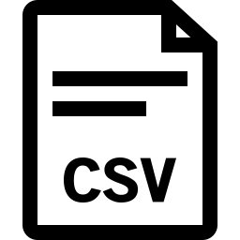
Maximo BIM w/ Autodesk Viewer Plugin Integration
BIM data can be exported from Revit in COBie format(.xls) using the BIM Interoperability Tools plugin for Revit. This data can then be imported into Maximo using the BIM Projects > COBie import session. This will create a set of Assets, Locations and other data in Maximo from the spreadsheet.
COBie
RVT
DWG
IFC
Translation from different formats to svf during upload process
https://aps.autodesk.com/
RVT
SVF
DWG
IFC
Model file (.rvt) is imported through Maximo into Forge Cloud and translated using the Model Derivative API (.svf or .svf2) to make it viewable in a web browser iframe (Maximo).

Slide 2
When exporting the data from Revit into COBie the GUID for each model component is capture as the external identifier.
This is set on the modelid field of the Location record created in Maximo

Slide 3
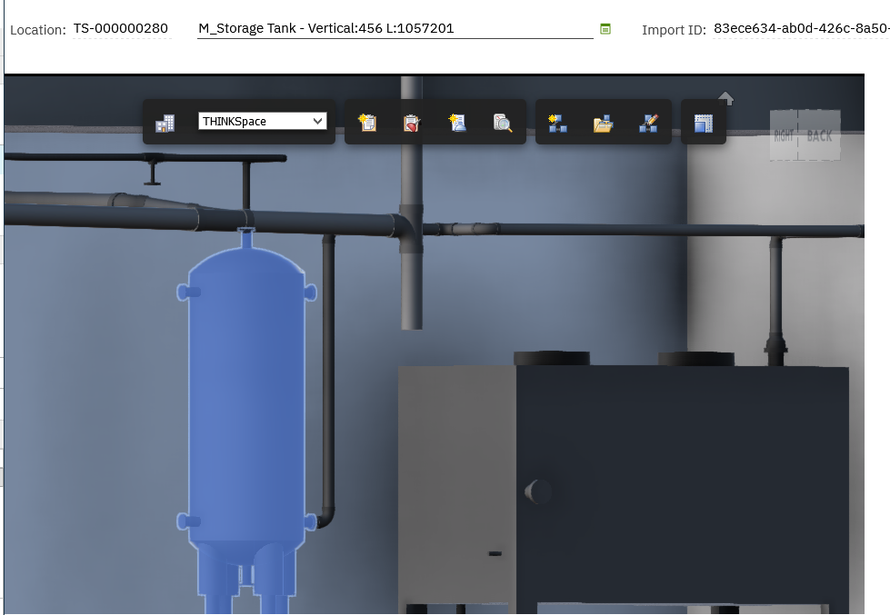
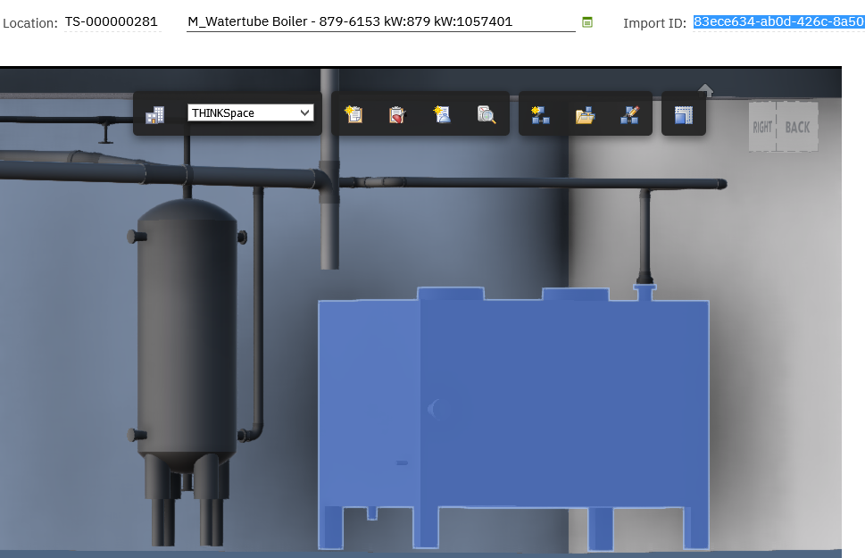
Result is when a location record is open in Maximo this modelid value is used to display the component in the model file. Also, when a different component in the model file is selected in the viewer the record in Maximo is selected based on the modelid.
Clicking on boiler in the viewer, changes the location record to boiler
Vertical tank is selected.

Slide 4
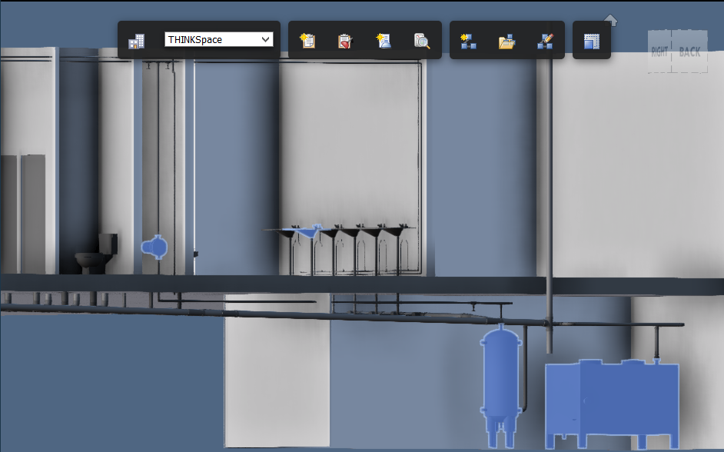
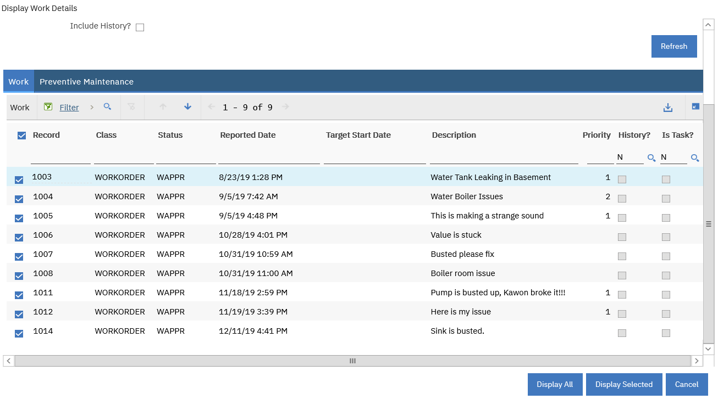
In the viewer we can select multiple components that are referenced by Maximo WO by clicking on Display Work Detail button in the Viewer and then Display All option in the dialog.
Here the components highlighted blue each have open WO in Maximo Work Order Tracking application

