Slide 1


MICHELIN
SPARE PARTS INVENTORY MANAGEMENT WITH MAXIMO
Sarah Caruana – Spare parts management Group leader
Jean-Laurent Balpe – IS Architect

Slide 2


#1
Identity card
Identity card | From siloed to pooled inventory | Maximo custom to fit the challenge | Value creation and road ahead | Setting the Maximo Standard for Client success
2

Slide 3

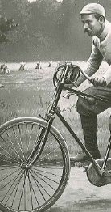

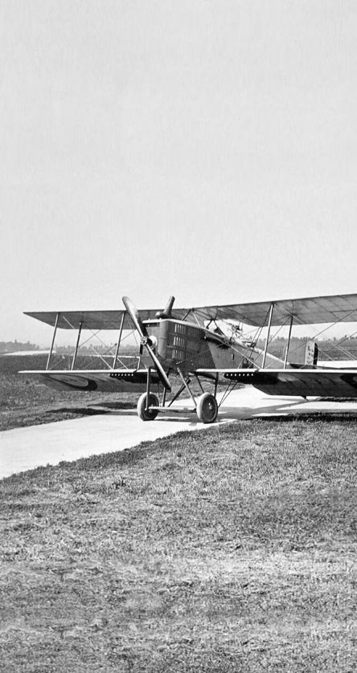
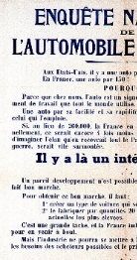
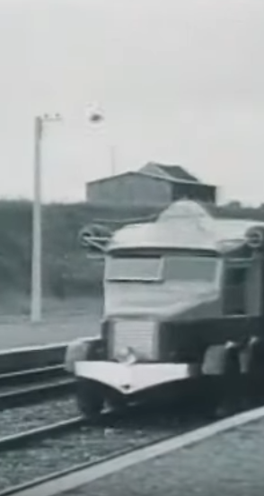
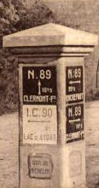


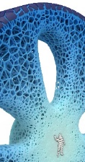

Over 130 years of innovation
2030
40% sustainable materials in our tires
1891
Detachable
tires
1900
The First
Michelin
Guide
1916
1st paved aviation
runway
2019
Creation of Symbio
1922
National survey instigating the democratization of automobiles
2017
The
VISION concept
1992
The
GREEN Tire
1929
Railcars
1946
RADIAL
Tire
1931
Road signs
Identity card | From siloed to pooled inventory | Maximo custom to fit the challenge | Value creation and road ahead | Setting the Maximo Standard for Client success
3

Slide 4

Key figures
A presence in
175
countries
132 000
people
€28.5 bn
sales
€2 BN
Net profit
121
Production sites
7 400
Distribution centers
€3.4 bn
Operating income
Identity card | From siloed to pooled inventory | Maximo custom to fit the challenge | Value creation and road ahead | Setting the Maximo Standard for Client success
4

Slide 5



sources of sustainable growth
Three fields of activity
Hydrogen
Medical
Flexible composite materials
20 to 30% of our sales will come from our activities around and beyond tires in 2030
Experiences
Beyond tires
3D Metal printing
Mobility intelligence
Fleet
management
Specialties
Connected services platform
Around tires
Road transport
With tires
Automobile
Identity card | From siloed to pooled inventory | Maximo custom to fit the challenge | Value creation and road ahead | Setting the Maximo Standard for Client success
5

Slide 6

Our “all sustainable” approach
“
Our vision of the future is built on one conviction: tomorrow, everything will be sustainable at Michelin. All our decisions are based on achieving a better balance between human, economic and environmental issues.
Florent Menegaux
CEO Michelin
People
&
Planet
”
Profit
Identity card | From siloed to pooled inventory | Maximo custom to fit the challenge | Value creation and road ahead | Setting the Maximo Standard for Client success
6

Slide 7


MAINTENANCE (TEC) IN ONE SENTENCE
Connecting people
Preserving the planet
Driving profits
through​
maintenance excellence​
Identity card | From siloed to pooled inventory | Maximo custom to fit the challenge | Value creation and road ahead | Setting the Maximo Standard for Client success
7

Slide 8
#2
FROM SILOTED TO POOLED INVENTORY
Identity card | From siloed to pooled inventory | Maximo custom to fit the challenge | Value creation and road ahead | Setting the Maximo Standard for Client success
8

Slide 9
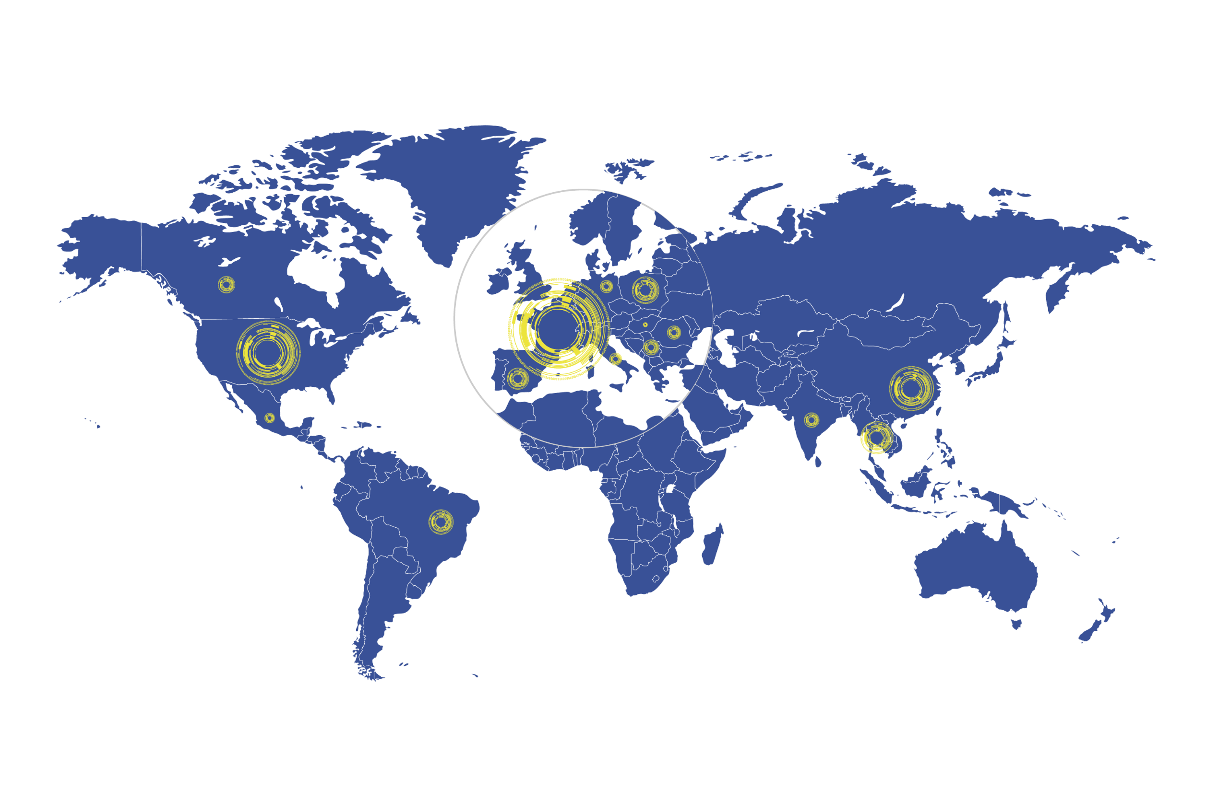

Tec Global Network
Europe
6210
EFFECTIVE figures at 31/12/2022
36 SITES
North and Central America
3630
Asia
2300
20 SITES
24 SITES
Brazil
1200
5 SITES
Identity card | From siloed to pooled inventory | Maximo custom to fit the challenge | Value creation and road ahead | Setting the Maximo Standard for Client success
9

Slide 10




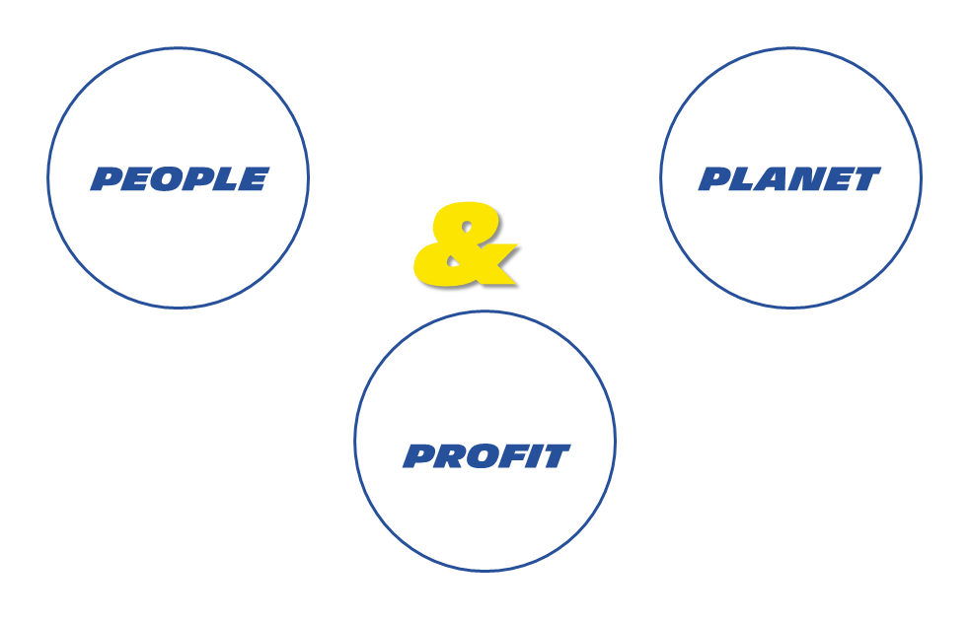

FROM HISTORICAL SILOED SPARE PARTS INVENTORIES…
EXCESS STOCK CONSUMPTION
POOLING
SUPPLIER
PLANT 1
PLANT 2
PLANT 1
PLANT 2
PLANT 3
PRIDE
ONE TEAM
SCRAPPING REDUCTION
4R MINDSET
Excess stock
Non movers
PARTS DESTRUCTION
Cash out versus « INHOUSE available consumption »
Free cash flow
Stock reduction
…TO SHARED MINDSET OPPORTUNITIES
Identity card | From siloed to pooled inventory | Maximo custom to fit the challenge | Value creation and road ahead | Setting the Maximo Standard for Client success
10

Slide 11









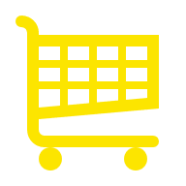
INVENTORY MANAGEMENT THOUGH SMART PROCUREMENT
Machine shutdown
Available stock
Work Order
Activities lists
Planning & Scheduling
Work execution
Work order completed
Promote repair
Planned maintenance
Reduce MOQ impact
Inventory management
Last option : external purchase
Identity card | From siloed to pooled inventory | Maximo custom to fit the challenge | Value creation and road ahead | Setting the Maximo Standard for Client success
11

Slide 12
#3
MAXIMO CUSTOM TO FIT THE CHALLENGE
Identity card | From siloed to pooled inventory | Maximo custom to fit the challenge | Value creation and road ahead | Setting the Maximo Standard for Client success
12

Slide 13
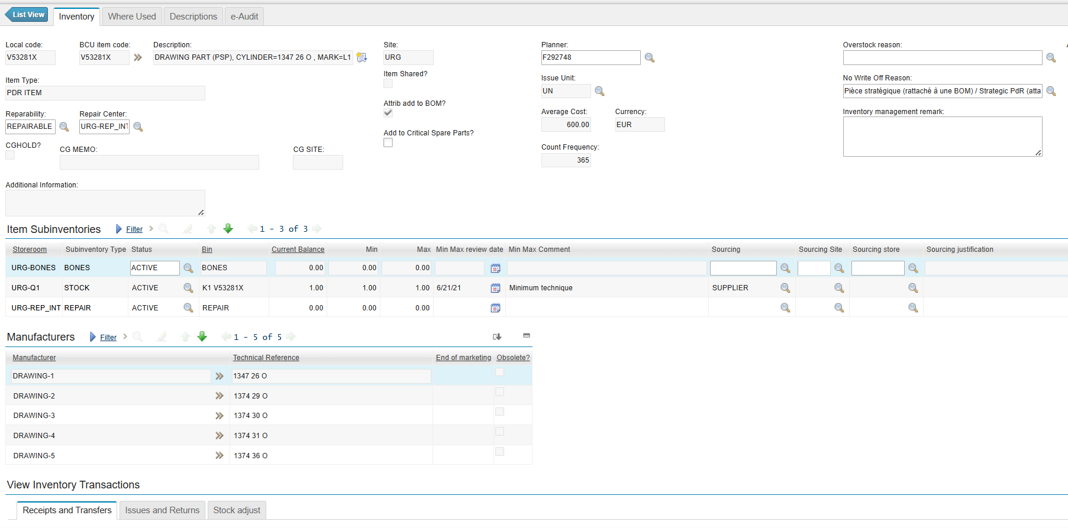
Default sourcing defined for the item and location
inventory SCREEN WITH DEFINED PARAMETERS
(sourcing, min/Max, storerooms…)
Replenishment manager
Criticity
Repairable or not
Identity card | From siloed to pooled inventory | Maximo custom to fit the challenge | Value creation and road ahead | Setting the Maximo Standard for Client success
13

Slide 14
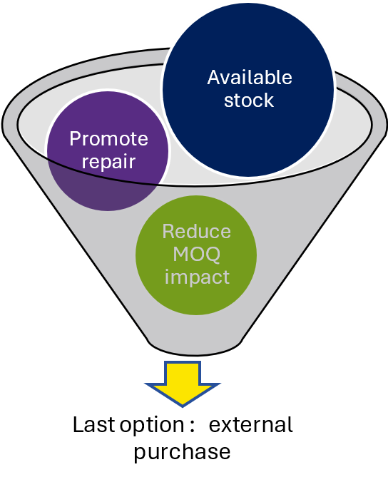
INVENTORY MANAGEMENT THOUGH SMART PROCUREMENT
Step 0 : Replenishment list display
Step 1 : Internal purchase from Michelin available stock (Overstock, items waiting for write-off)
Step 2 : Repairable items to send to repair (according to BONES available stock)
Step 3 : Internal sourcing based on sourcing in item screen
Example : main store to sector store or central platforme to local sites
Step 4 : External Supplier
Step 5 : Synthesis and transaction creation
Identity card | From siloed to pooled inventory | Maximo custom to fit the challenge | Value creation and road ahead | Setting the Maximo Standard for Client success
14

Slide 15
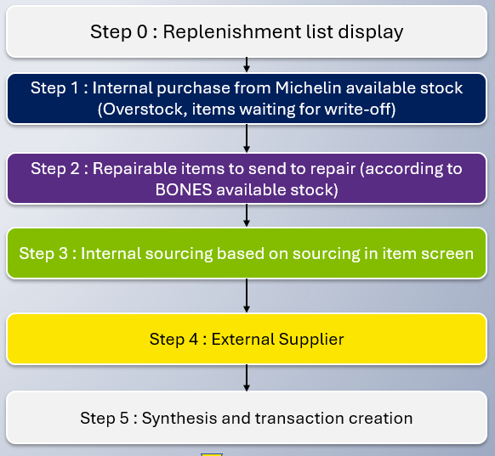
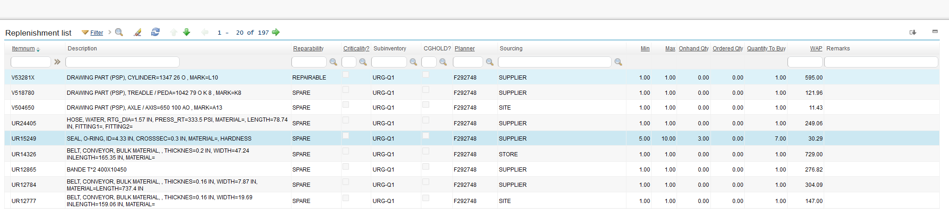
Step 0 : Replenishment list display
Items in inventory at the SITE that need to be procured (balance < MIN, considering pending orders)
Possibility to filter on a replenishment manager
Default sourcing defined for the item and Storeroom
Possibility to filter on a STOREROOM in the SITE
Quantity to buy : calculated based on MIN/MAX, current balance and orders
Identity card | From siloed to pooled inventory | Maximo custom to fit the challenge | Value creation and road ahead | Setting the Maximo Standard for Client success
15

Slide 16
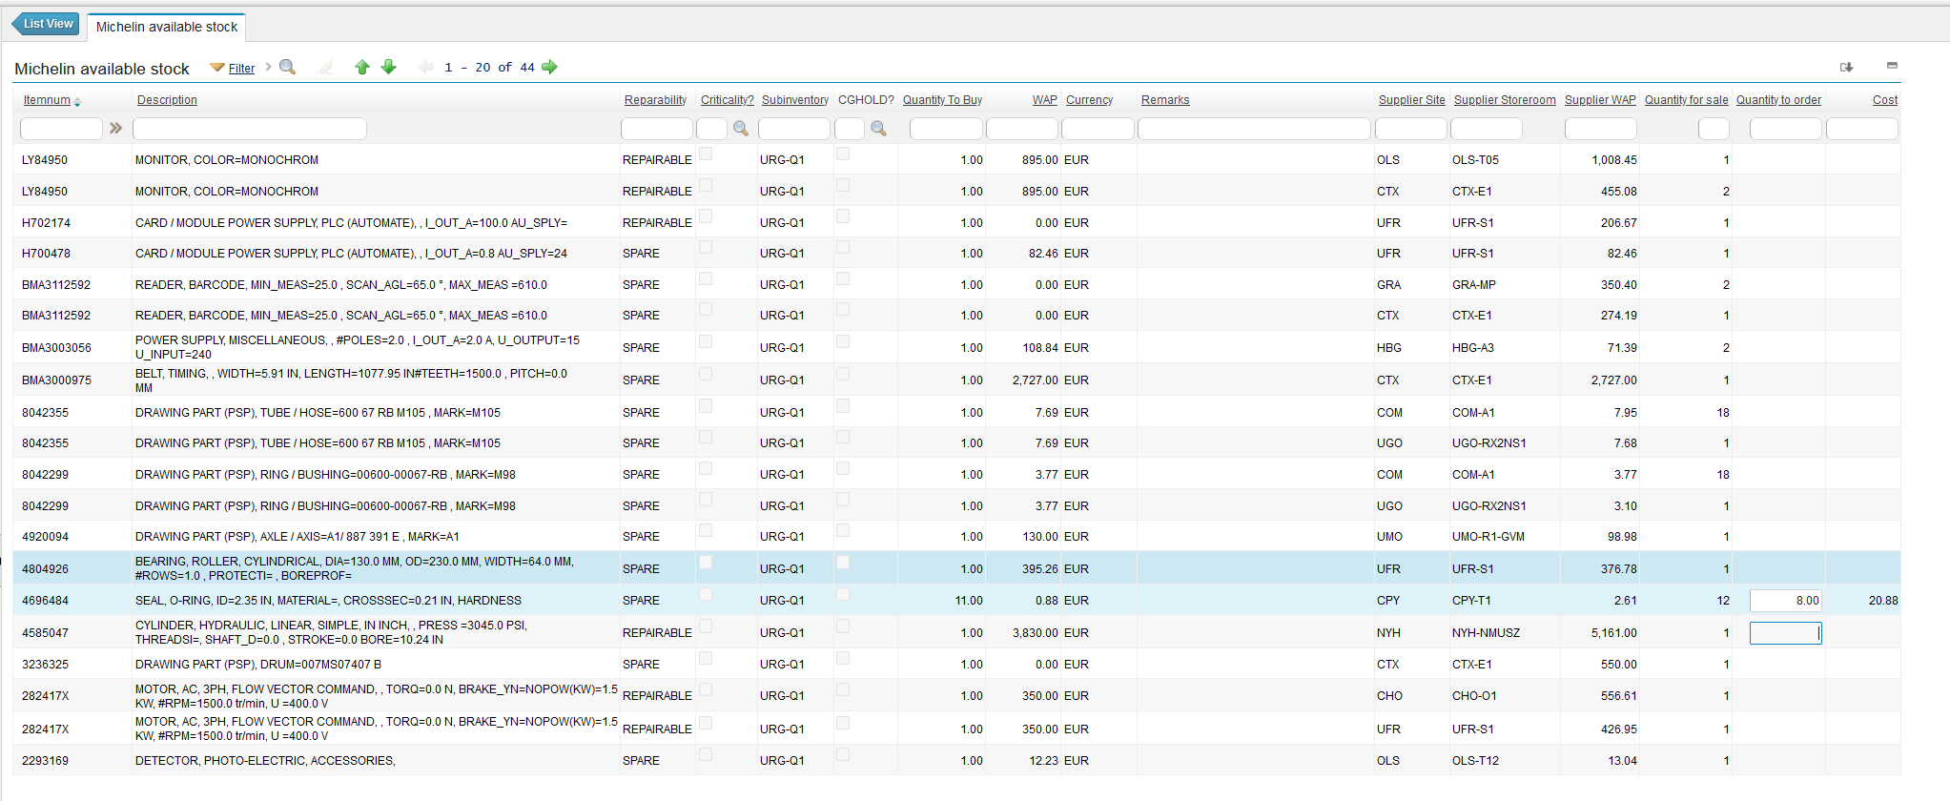
Step 1 : Internal purchase from Michelin available stock (Overstock, items waiting for write-off)
Against each item requiring replenishment, the excess inventory in any storeroom is shown for the user to be picked
Quantity to source from available stock (user choice)
Quantity in excess and associated average price
Identity card | From siloed to pooled inventory | Maximo custom to fit the challenge | Value creation and road ahead | Setting the Maximo Standard for Client success
16

Slide 17
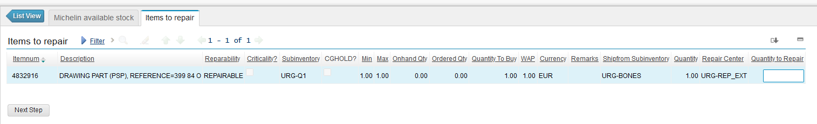
Step 2 : Repairable items to send to repair (according to AVAILABLE BROKEN PARTS)
Against each REPAIRABLE item of the list, the available broken parts at SITE are shown to be sent for repair
Updated with previous decision (reduced)
Available item quantity on the site to be repaired (from BONES Storeroom)
Identity card | From siloed to pooled inventory | Maximo custom to fit the challenge | Value creation and road ahead | Setting the Maximo Standard for Client success
17

Slide 18
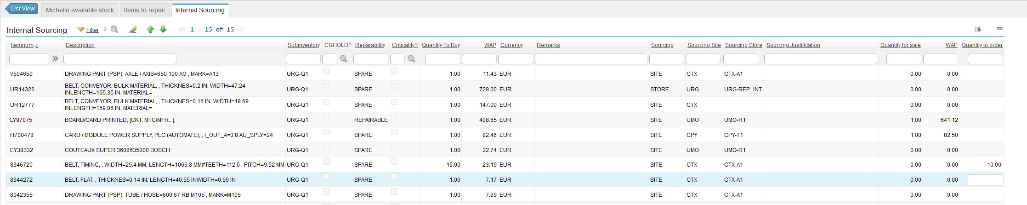
Step 3 : Internal sourcing based on INVENTORY screen SOURCING PARAMETER
Against each INTERNALLY SOURCED item requiring replenishment, the defined source is shown
Quantity to be ordered from another storeroom
(user choice)
Updated with previous decision (reduced)
Quantity in stock and associated average price
Identity card | From siloed to pooled inventory | Maximo custom to fit the challenge | Value creation and road ahead | Setting the Maximo Standard for Client success
18

Slide 19
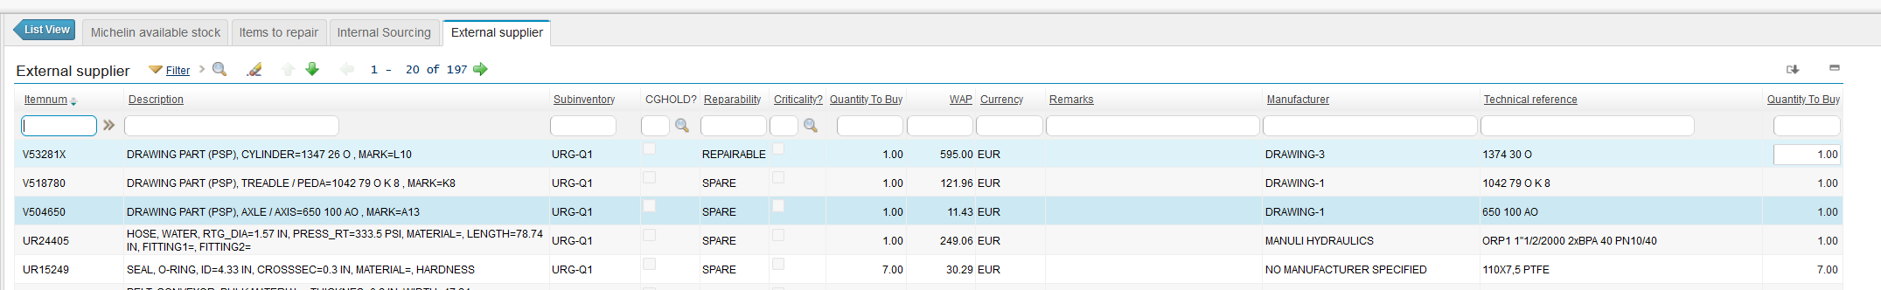
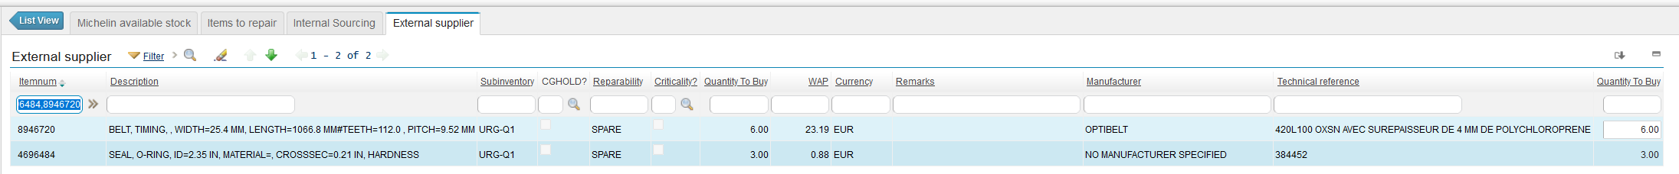
Step 4 : External Sourcing
All remaining quantities that haven’t been replenished in the previous steps mean are shown to be ordered from the external supplier
Updated with previous decision (reduced)
Quantity to be ordered from a supplier
(user choice)
Identity card | From siloed to pooled inventory | Maximo custom to fit the challenge | Value creation and road ahead | Setting the Maximo Standard for Client success
19

Slide 20
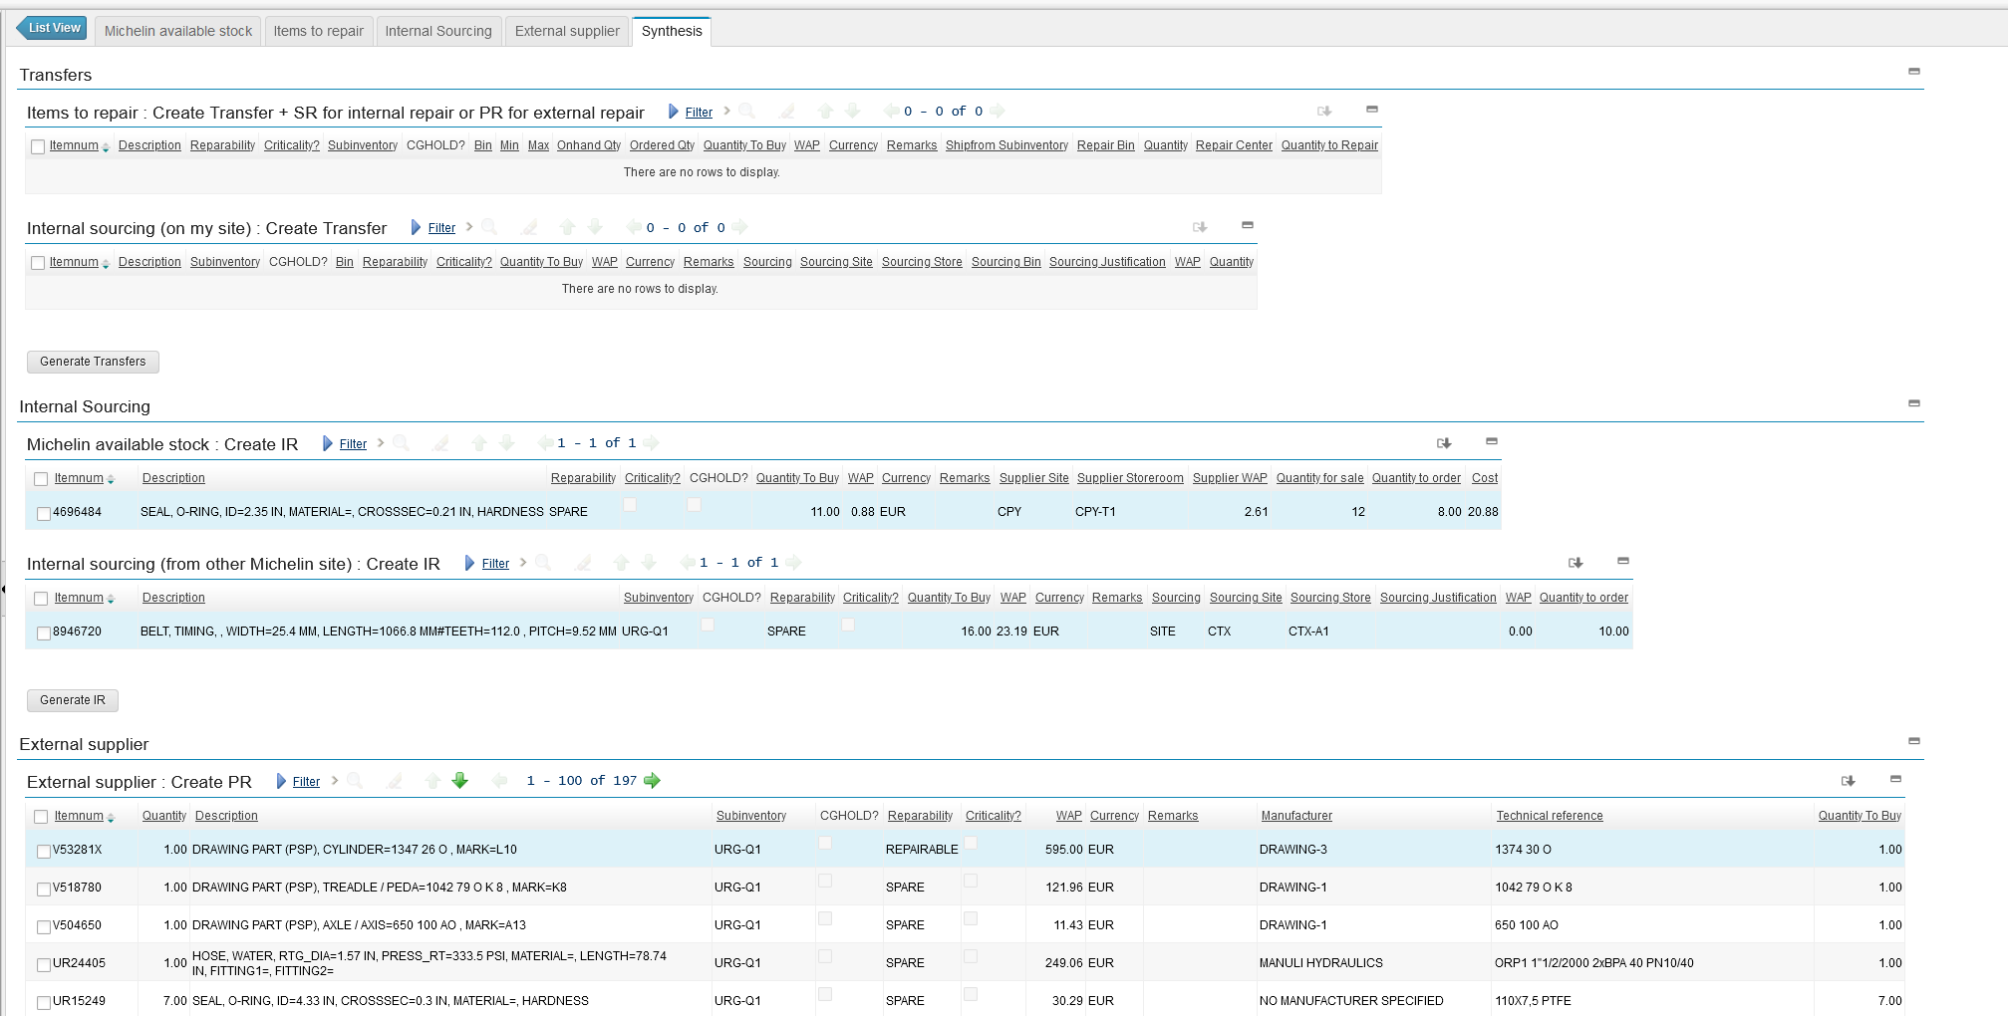
Step 5 : Synthesis and transaction creation
Transactions between different sites
Transactions within the same site
External purchase transactions
Identity card | From siloed to pooled inventory | Maximo custom to fit the challenge | Value creation and road ahead | Setting the Maximo Standard for Client success
20

Slide 21
#4
VALUE CREATION AND ROAD AHEAD
Identity card | From siloed to pooled inventory | Maximo custom to fit the challenge | Value creation and road ahead | Setting the Maximo Standard for Client success
21

Slide 22


VALUE GENERATED, Evolutions and enhancements
> 30M€ of PARTS EXCHANGE IN 5 YEARS
OVERSTOCK CONSUMPTION
Allow and enforce planned operations to consume available overstock before specific external ordering
INFORMATION SHARE
Include in the replenishment application
Existing supply routes between sites
Landing cost estimation
Leadtime management
PREDICTIVE INVENTORY
Include previous consumptions and needs from breakdown predictions in replenishment application
OVERSTOCK PREVENTING
Automatically prevent external purchase when a reasonably close site has overstock
Identity card | From siloed to pooled inventory | Maximo custom to fit the challenge | Value creation and road ahead | Setting the Maximo Standard for Client success
22

Slide 23
#5
Setting the Maximo standard for client succesS
Identity card | From siloed to pooled inventory | Maximo custom to fit the challenge | Value creation and road ahead | Setting the Maximo Standard for Client success
23

Slide 24


Setting the Maximo Standard
Need to maintain the application and develop adaptations for maximo version upgrade
Michelin developed a specific application to manage this inventory module
Incompatibity with migration to maximo SaaS solution
Do you have some needs that this module can cover?
Can IBM make this a standard Maximo module?
VOTE FOR US ☺ !!​
Identity card | From siloed to pooled inventory | Maximo custom to fit the challenge | Value creation and road ahead | Setting the Maximo Standard for Client success
24

